Slide 1
Predicting Pulsar star using machine learning
Guided By: J Jyotsna
Assistant Professor
Prepared By:
Prashanth Yarram
20675A1202

Slide 2
INTRODUCTION
A pulsar is a quickly pivoting neutron star. A neutron star is one of the endpoints of the life of a massive star after it explodes in a supernova explosion. A neutron star is one of the end purposes of the life of a gigantic star after it detonates in a supernova blast. This magnetic field is not aligned with the rotation axis of the neutron star. To watch these beats of radiation at whatever point the attractive post is obvious. The beats come at a similar rate as the revolution of the neutron star, and, along these lines, seem occasional. In spite of, before long, radio repeat impedance and fuss can create signals that resemble that of pulsars, so it's particularly intriguing to think of an approach to characterize among pulsars and radio recurrence obstruction or noise and Machine Learning Technology proves to be a perfect stop to simplify and automate this manual task

Slide 3
ABSTRACT
A pulsar is an exceptionally polarized pivoting neutron star or white smaller person that emits a light emission radiation. This radiation can be watched just when the light emission is highlighting Earth and is answerable for the beat appearance of emanation. To predict these pulsar stars, we are implementing the model using some machine learning algorithms like decision tree, random forest, etc. Pulsars are one of the possibilities for the wellspring of ultra-high-vitality enormous beams

Slide 4
Literature survey
Literature survey is the most important step in software development process. Before developing the tool, it is necessary to determine the time factor, economy and company strength.
Once these things are satisfied, then next step is to determine which operating system and language can be used for developing the tool.
Once the programmers start building the tool the programmers need lot of external support. This support can be obtained from senior programmers, from book or from websites.

Slide 5
Literature survey
Before building the system the above considerations are taken into account for developing the proposed system.
A literature review is a body of text that aims to review the critical points of current knowledge including substantive findings as well as theoretical and methodological contributions to a particular topic.
Literature reviews are secondary sources, and as such, do not report any new or original experimental work. Also, a literature review can be interpreted as a review of an abstract accomplishment.

Slide 6
EXISTING SYSTEM
One of the challenges experienced during the scans for pulsars in the previous fifty years is the investigation required for the expanding number of 'competitor' pulsar locations emerging from an expanding volume of information to be looked at. From basic channels to another principled continuous characterization approach utilize factual grouping to separate 8 new highlights to limit the number of highlights without reducing arrangement execution. Every up-and-comer is a potential recognition of a pulsar signal, which displays explicit qualities of intrigue. Precise choices must be made. Mix-ups can prompt the expensive misuse of telescope time on fake signs, and more regrettable, missing legitimate signs altogether.

Slide 7
DRAWBACKS OF EXISTING SYSTEM
It an Expensive process to find pulsar star using telescopes as there are many fake signs which waste our precious research time.
Searching for pulsars is a very labor-intensive process, currently requiring skilled people to examine and interpret plots of data output by analysis programs.

Slide 8
PROPOSED SYSTEM
In the proposed system, we will be using the different parameters to detect the pulsar star that are already calculated and given in dataset and using this dataset we will training multiple machine learning algorithms and evaluate them to get a best model to detect pulsar star.

Slide 9
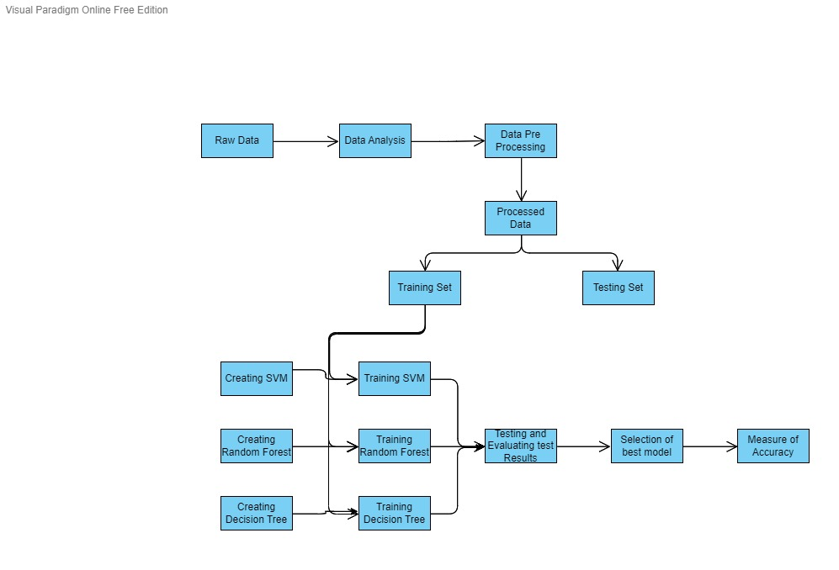
Architecture diagram

Slide 10
ADVANTAGES OF PROPOSED SYSTEM
Reducing the human labor by using the intelligence and computational power of the machine.
It is a very cost-efficient method as it does not require a lot of to detect a pulsarstar.
In the proposed machine learning model for detecting pulsar candidates, it is proved that the system is both faster and accurate and reliable.

Slide 11
Software requirements
Python 3.5.
Anaconda Navigator.
Windows 7 or above.
Packages: numPy, Pandas, matplotlib, seaborn, sci-kitlearn

Slide 12
Hardware requirements
Ram 4GB
Storage 512GB
CPU 2GHz
Intel i3 or Higher
Architecture 32bits or 64bits

Slide 13
Functional requirements
Ability to process the data to find the data of the star that resembles the pulsar star.
Ability to differ a start which is not a pulsar star from one that is a pulsar star.
Able to visualize the results to end users.

Slide 14
Non Functional requirements
Accurate results.
Compatibility
Fast response.

Slide 15
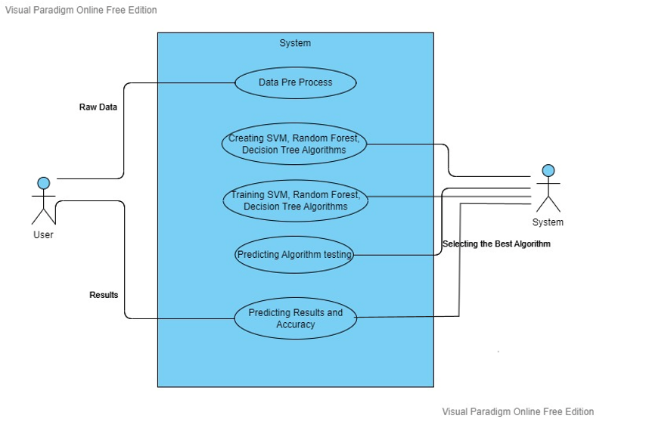
Use case diagram

Slide 16
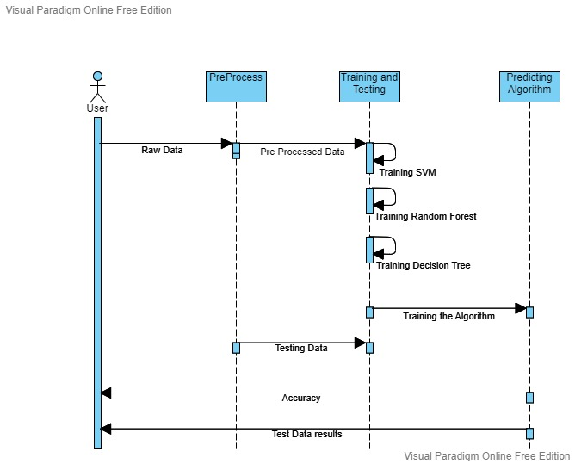
Sequence diagram

Slide 17
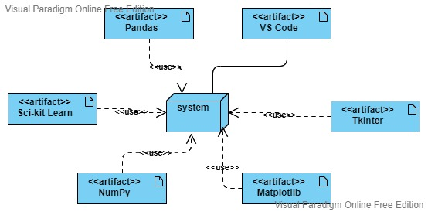
Deployment diagram

Slide 18
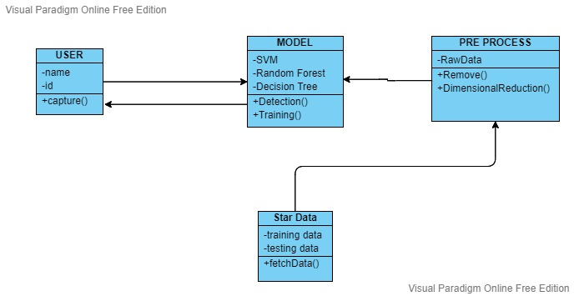
Class diagram

Slide 19
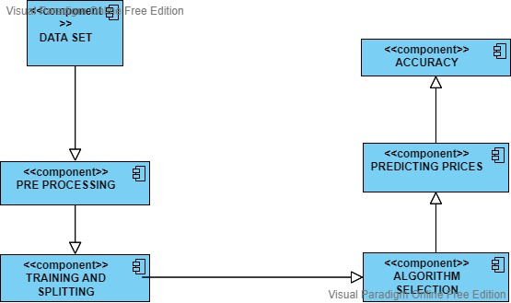
Component diagram

Slide 20
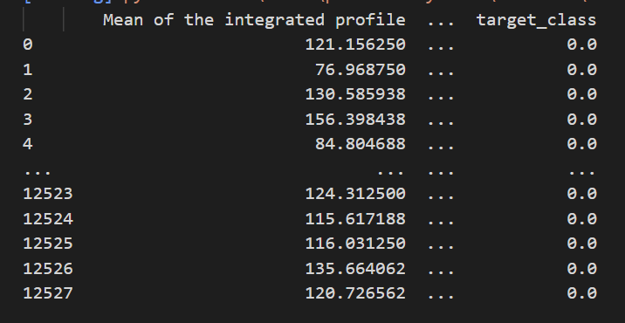
Result screens
NAVIGATION:
Run The python project giving the training data set as input
It will display all the training data set data

Slide 21
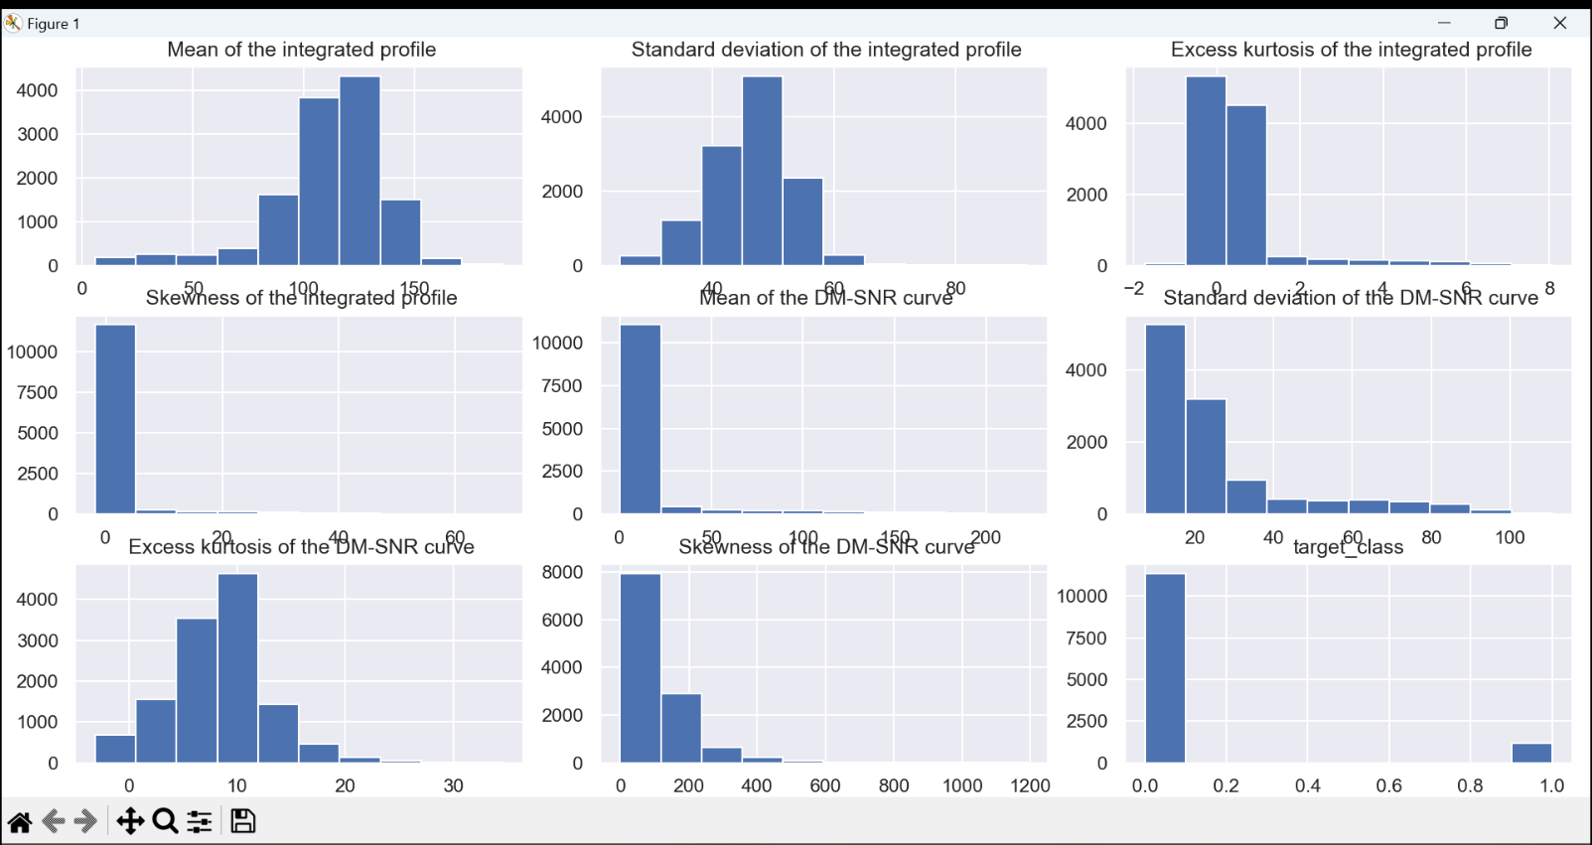
Result screens
NAVIGATION:
All the graphs will run one after the other when you close the previous graph figure.
Close the current graph.

Slide 22
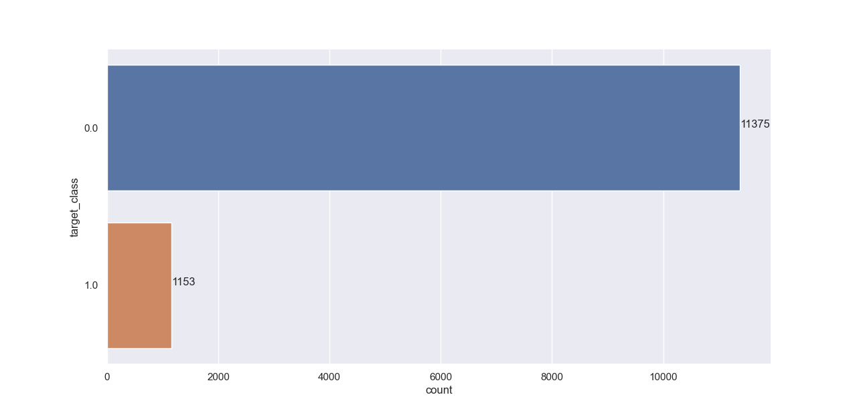
Result screens
NAVIGATION:
Close the previous graph.
It will automatically pop up all the graphs for all attributes and confusion matrices for all the algorithms.

Slide 23
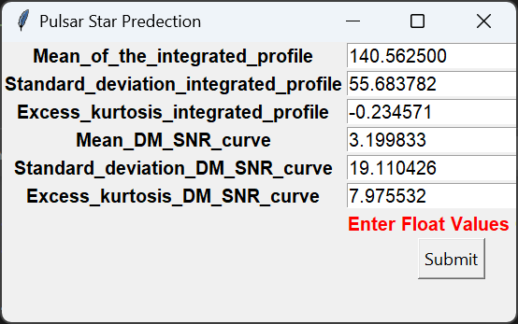

Result screens
NAVIGATION:
After all the algorithms are trained based on the accuracy we select the best algorithm
After closing the graphs it will automatically popup a python GUI window
Fill the input fields with the star values that we need to predict which are shown above.
Press submit button to find out the results.
It will open a new window with the result being “Not a Pulsar” in this case.

Slide 24
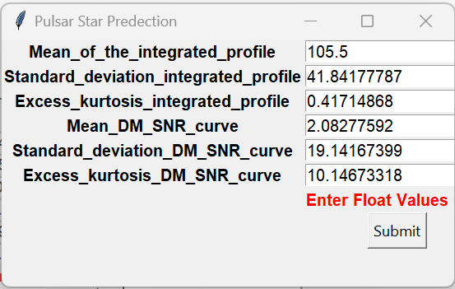
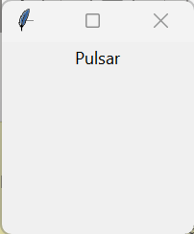
Result screens
NAVIGATION:
After closing the previous output window.
Fill the input fields with the star values that we need to predict which are shown above.
Press submit button to find out the results.
It will open a new window with the result being “Pulsar” in this case.

Slide 25
Test cases
Sl No | Description | Steps to produce | Expected output | Actual output | Result
1 | Predict if Pulsar star or not | Enter all the star details | Pulsar or Not pulsar According to the input | Enter Float values only | Fail
2 | Predict if Pulsar star or not | Enter all the star details | Pulsar or Not pulsar According to the input | Pulsar | True
3 | Predict if Pulsar star or not | Enter all the star details | Pulsar or Not pulsar According to the input | Not Pulsar | True

Slide 26
conclusion
In this project, we have executed 3 Machine learning models: Decision Tree Classifier, Random Forest Classifier, and Support Vector Machine to discover the pulsar star competitors. They utilize a measurable technique to produce a reasonable dataset to test the 4 models. Among these models, Random Forest Classifier plays out the best on the all-out precision while different models are just marginally more terrible than it. Our models will be helpful, and particularly Random Forest model, for future pulsar star distinguishing proof in the region of cosmology. On the off chance that pulsar stars can be discovered dependent on our forecasts, our models end up being helpful in an application

Slide 27
Further enhancement
In the future, by applying different methods and techniques it can improve the accuracy score and the results can become more accurate. Test our models in more pulsar star competitor datasets other than HTRU2 to know the results accurately. Generate a superior dataset, incorporate more highlights that are in the first HTRU2 datasets, and key portrayals of Pulsars and is bigger and adjusted. Utilize better adjusting techniques to create better disseminated counterfeit information. In the event that pulsar stars can be discovered dependent on our forecasts, our AI models end up being valuable in the application.

Slide 28
references
[1] R. P. Eatough, N. Molkenthin, M. Kramer, A. Noutsos, M. J. Keith, B. W. Stappers, and A. G. Lyne, “Selection of radio pulsar candidates using artificial neural networks,” Monthly Notices of the Royal Astronomical Society, vol. 407, pp. 2443–2450, 07 2010.
[2] S.Bates, M.Bailes, B.Barsdell, N.Bhat, M.Burgay, S. Burke-Spolaor, D. Champion, P. Coster, N. D Amico, A. Jameson, et al., "the high time resolution universe pulsar survey A Tvi. an artificial neural network and timing of 75 pulsars ", Monthly Notices of the Royal Astronomical Society, vol. 427, no. 2, pp. 1052-1065, 2012.
[3] R. J. Lyon, Why are pulsars hard to find? Ph.D. thesis, The University of Manchester (United Kingdom), 2016.
[4] Schoelkopf B, Burges C J C, Smola A J, Advances in Kernel Methods - Support Vector Learning. Cambridge: MIT Press, 1999.
[5] Machine Learning Approach to Detect Pulsar Star: TensorFlow and Random Forest Model with Python
[6] R. J. Lyon, B. Stappers, S. Cooper, J. Brooke, and J. Knowles, “Fifty years of pulsar candidate selection: from simple filters to a new principled real-time classification approach,” Monthly Notices of the Royal Astronomical Society, vol. 459, no. 1, pp. 1104–1123, 2016. [7] D. R. Lorimer, M. Kramer, et al., Handbook of pulsar astronomy, vol. 4. Cambridge university press, 2005.
[8] R.N.Manchester and J.Taylor, “pulsars”, Freeman, SranFcisco, 1977.

Slide 29
THANK YOU

